Slide 1


Sam
14 December 2024

Slide 2

Outline
Executive Summary
Introduction
Methodology
Results
Conclusion
Appendix

Slide 3
Executive Summary
Summary of methodologies
Data Collection:
SpaceX API launch data and web scrapping
Data Wrangling:
Clean and format data
Store data to database and do SQL queries
Standardization
Visualizations:
Interactive visualization with Folium
Dashboard with Plotly Dash
Model Building & Evaluation:
SVM, Decision Trees, K-Nearest Neighbors, GridSearchCV
Evaluate models by accuracy
Summary of Results
Data analysis:
Find factors contributing to landings successful rates
Visualizations correlations between factors
Model evaluation:
Test accuracy of different models
Key findings:
Launch location and payload mass influence success rates
Decision Tree model perform the best (94% accuracy)

Slide 4
Introduction
Background
SpaceX revolutionized the space industry by offering rocket launches at significantly lower costs, primarily due to their ability to reuse the first stage of the rocket. This project aims to predict the successful landing of the Falcon 9 first stage, helping estimate launch costs and providing insights for companies competing with SpaceX.
Problems to be included
Factors that determine successful landings
Relationship between factors and its importance
Best machine learning model that performs best prediction

Slide 5

Section 1

Slide 6
Methodology
Executive Summary:
Data collection methodology: SpaceX API and web scrapping
Perform data wrangling: Handle missing values, standardizing data, extract and create new features.
Perform exploratory data analysis (EDA) using visualization and SQL
Perform interactive visual analytics using Folium and Plotly Dash
Perform predictive analysis using classification models:
Built models like Logistic Regression, SVM, KNN and Decision Trees.
Use GridSearchCV for hyperparameter tuning

Slide 7
Data Collection
Data is collected by SpaceX REST API and Web Scrapping from Wikipedia.
Request is made follow by data fetching and parsing. Those collected data is then streamlined to perform cleaning and transformation. In collection process, it is important to keep data structured well organized to avoid revisiting collection process during data analysis steps.
Collect
SpaceX API
Web scrap
Processing
Transform
Parse
Store
Database
Fetch with SQL

Slide 8
Data Collection – SpaceX API
Send API request
SpaceX API endpoint
Python requests library
Parse API response
JSON format
Pandas DataFrame
Store data
Extract useful fields
Stored locally
Send API request
Python requests library allow user to send get request to end point which is connected to SpaceX API
Parse response
Received response will be parsed to a pandas dataframe in JSON format
Store data:
Extract useful fields and saved it locally
Github: https://github.com/SamLo322/course-project-AppliedDataScienceCapstone/blob/be484cdbcc510814d5deffea5e1b46fde9dcea87/1.%20jupyter-labs-spacex-data-collection-api.ipynb

Slide 9
Data Collection - Scraping
Send API request
Python requests library can fetch target page HTML content
Parse response
Python Beautiful soup library can parse HTML content to capture useful information
Store data
Extract useful data and store in Pandas DataFrame
Github: https://github.com/SamLo322/course-project-AppliedDataScienceCapstone/blob/be484cdbcc510814d5deffea5e1b46fde9dcea87/2.%20jupyter-labs-webscraping.ipynb
Request Wiki page from url
Parse HTML element with Beautiful soup library
Extract useful information and store it in pandas DataFrame

Slide 10
Data Wrangling
Data Wrangling process is to transform and clean messy and unstructured data into useful form that can be carried forward for exploratory data analysis.
Data Cleaning
Replace nan values with mean value of dataset
Extract useful information by dropping rows and columns
Data integration and transformation
Standardize column format into DataFrames object
Integrate DataFrames object from different data source
Data Validation
Remove duplicate recores and perform consistency check
Github: https://github.com/SamLo322/course-project-AppliedDataScienceCapstone/blob/be484cdbcc510814d5deffea5e1b46fde9dcea87/3.%20labs-jupyter-spacex-Data%20wrangling.ipynb
Replace empty values
Identify
Drop / Replace value
Data engineering
Standardize dataset
Feature Engineering
Verification
Consistency
Duplicates
Construct DataFrames
Accuracy

Slide 11
EDA with Data Visualization
Summarize what charts were plotted and why you used those charts
Histograms – Visualize statistic such as launch success rates and payload mass, it helps generate data insights such as tendency and inter-category comparisons
Bar Charts – Visualize launch outcomes across launch sites or rocket types to compare success rates and find best type
Line Charts – Visualize success rate over time, time series plot over period helps identify trends
Scatter Plots – Show relationship across two dimension to perform comparison and find dependencies and correlations
Heatmaps – show matrices across variables that help identify correlation trends
Github: https://github.com/SamLo322/course-project-AppliedDataScienceCapstone/blob/be484cdbcc510814d5deffea5e1b46fde9dcea87/5.%20edadataviz.ipynb

Slide 12
EDA with SQL
SQL Queries:
Grab success and fail launches, get average or total data grouped by launch site and rocket type
Filter data by launch outcomes, dates, payload masses and rocket types
Sort and order data by wanted means such as date or type
Nested queries to find max or average statistic such as average payload mass grouped by launch site
Github: https://github.com/SamLo322/course-project-AppliedDataScienceCapstone/blob/be484cdbcc510814d5deffea5e1b46fde9dcea87/4.%20jupyter-labs-eda-sql-coursera_sqllite.ipynb

Slide 13
Build an Interactive Map with Folium
In order to visualize rocket launch location, we capture the launch latitude and longitude coordinates and mark them on the interactive map using Folium
Map objects plotted:
Markers:
- Outline the exact launch locations of rocket launch in order to give clear image of where launch location is distributed over the past period
Circles:
- Outlines the areas that is critical to ensure controllability over rocket launch such as safety and operational needs
Lines:
Highlights the distance between launch locations and connected nearby areas to enhance understanding from an overview
Github: https://github.com/SamLo322/course-project-AppliedDataScienceCapstone/blob/be484cdbcc510814d5deffea5e1b46fde9dcea87/6.%20lab_jupyter_launch_site_location.ipynb

Slide 14
Build a Dashboard with Plotly Dash
Interactive dashboard of Pie Chart and Scatter plots
Pie Chart
Shows success and fail launches
Scatter Plots
Shows correlations of payload mass and success rates to give insight where threshold shall be set
Github: https://github.com/SamLo322/course-project-AppliedDataScienceCapstone/blob/47184b02f92bb4f0192dfb308b0f9f3c34bde3c0/spacex_dash_app.py

Slide 15
Predictive Analysis (Classification)
Construct model
Input dataset to DataFrame
Pick Machine Learning model to use with
Model Evaluation
Test the accuracy scores with the report and confusion matrix
Rank the accuracy across each models
Pick best model
Feature engineering and parameters tuning of each model
Select the model with best accuracy for this dataset
Transform data into trainable format
Split dataset into training and testing dataset
Adjust hyperparameters of each model
Github: https://github.com/SamLo322/course-project-AppliedDataScienceCapstone/blob/47184b02f92bb4f0192dfb308b0f9f3c34bde3c0/7.%20SpaceX_Machine%20Learning%20Prediction_Part_5.ipynb

Slide 16
Results
Results is then displayed as
Exploratory data analysis results
Interactive analytics demo in screenshots
Predictive analysis results

Slide 17

Section 2

Slide 18
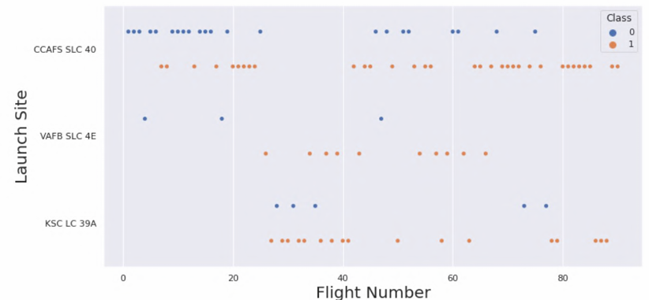
Flight Number vs. Launch Site
Blue dot indicate unsuccessful landings while orange ones indicate successful landings.
On the Y-axis it shows the distribution of successful rates over different launch sites.
Combine both shows that successful rates increase as number of launches is sent in each site

Slide 19
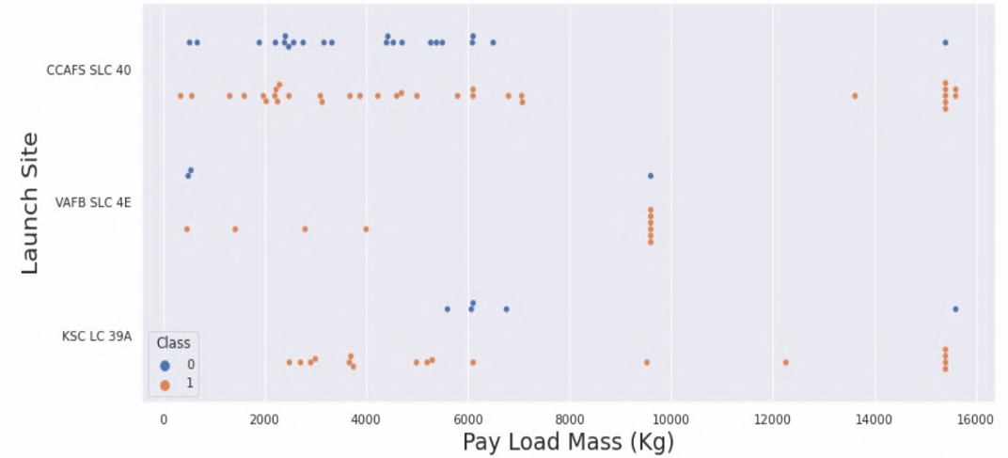
Payload vs. Launch Site
This plot show that the successful rate of launches increased with payload over 9000 kg.
Besides payload below 4000 kg on KSC LC 39A site has a 100% successful rate

Slide 20
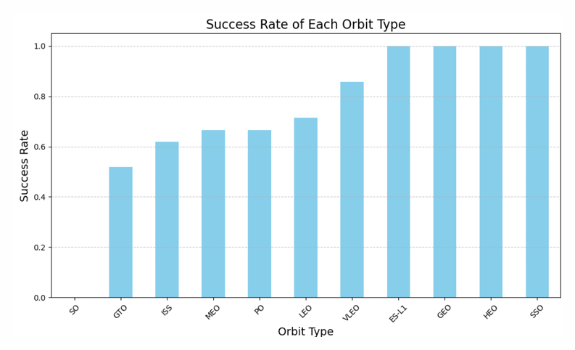
Success Rate vs. Orbit Type
This plot shows that orbit type highly influence success rate, and achieve 100% successful rate for SSO.
However should bare in mind spots like GEO, SO, and SEO only has 1 occurrence indicating that the figure is biased at the moment

Slide 21
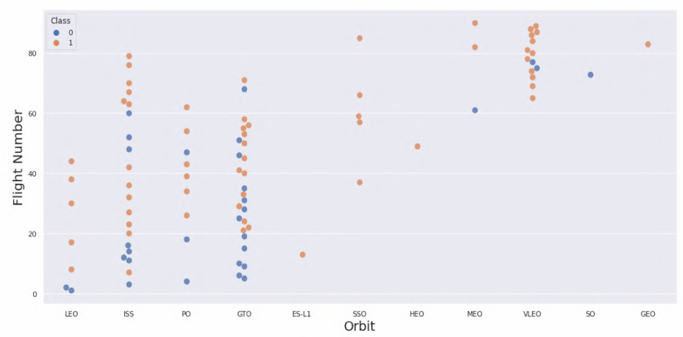
Flight Number vs. Orbit Type
The plot show that flight is shifted from LEO ISS and GTO to VLEO, which has a higher successful rate.
ISS and GTO has the most occurrence with a trend of increasing successful rates.

Slide 22
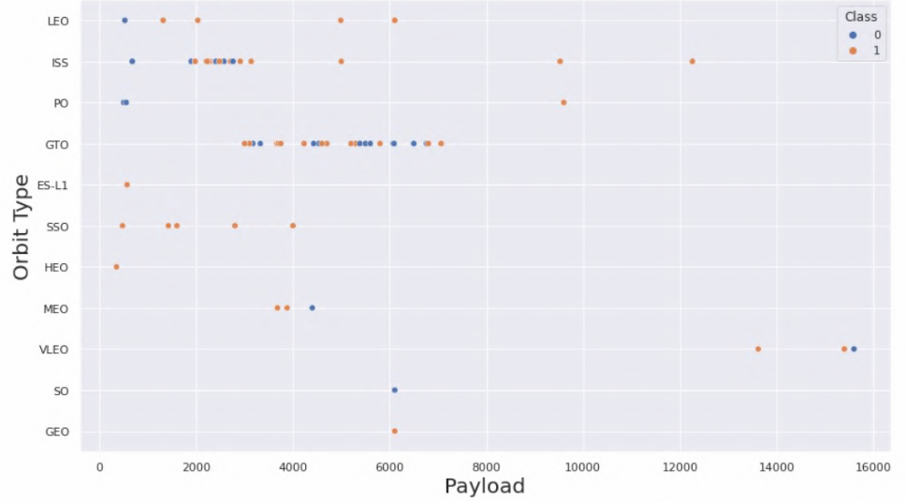
Payload vs. Orbit Type
This plot show relationship between Payload and Orbit type.
Figure shows an unequal distribution of orbit types and launches, as well as the Payload.
For instance SSO is relatively more good at launching low Payload with GTO and ISS is good at 4000~6000 and 2000~3000 Payload respectively

Slide 23
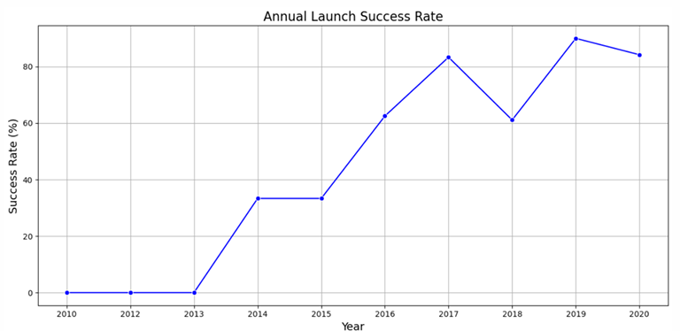
Launch Success Yearly Trend
This time series plot shows the average launch success rate over each year, this shows that improvement and optimization from the engineering team has did a good job in optimizing launch steps and aim for a higher successful ate.

Slide 24
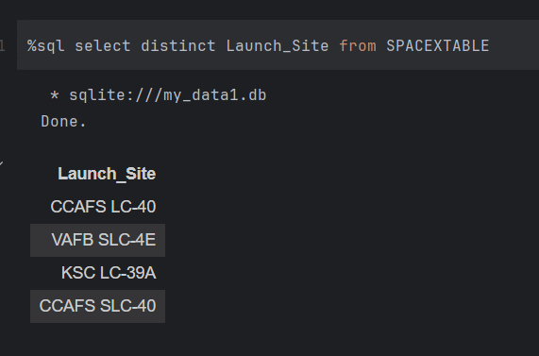
All Launch Site Names
The SQL query used to show unique launch sites:

Slide 25
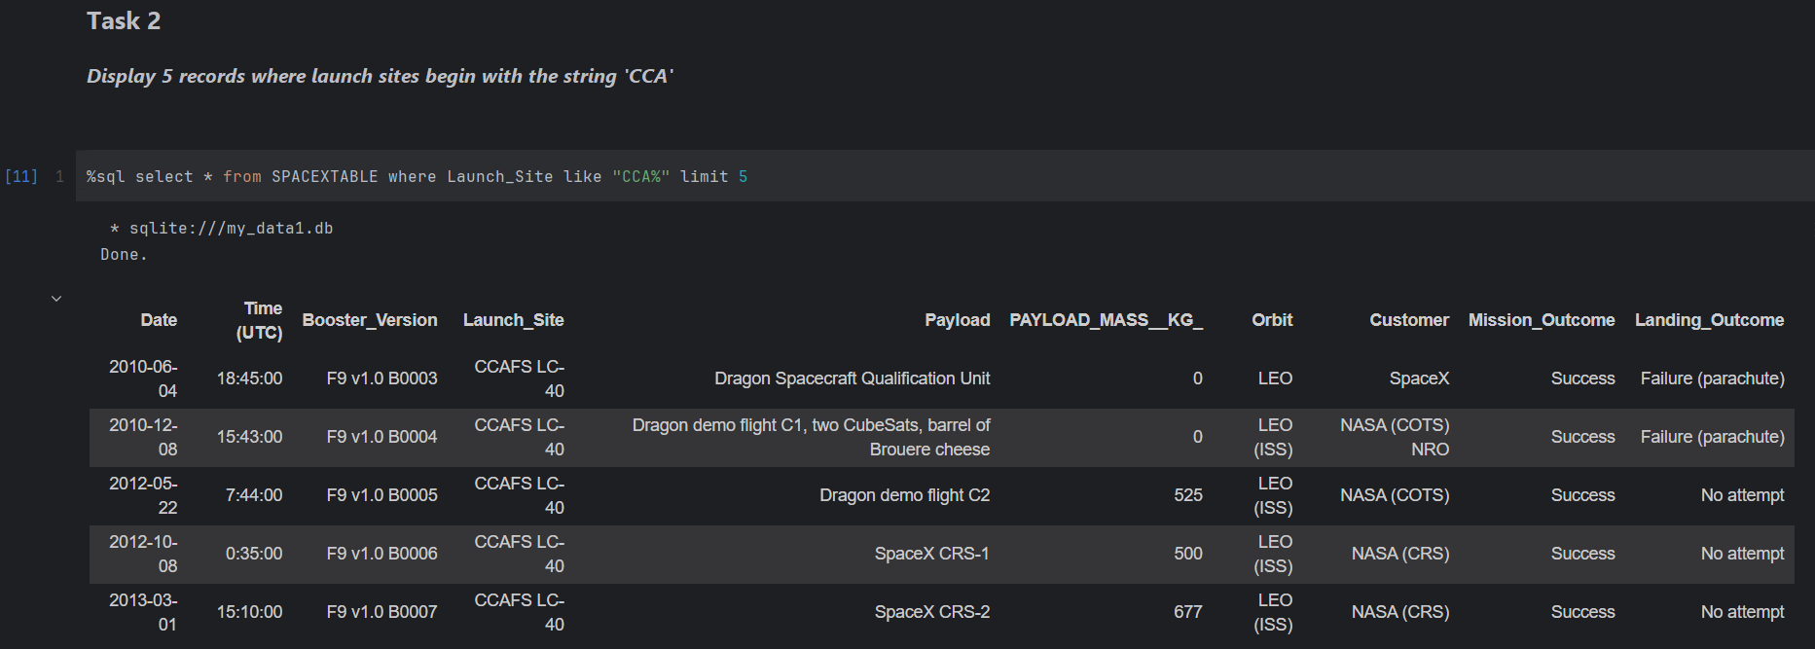
Launch Site Names Begin with 'CCA'
SQL to find first 5 records with launch sites begin with `CCA`:
The SQL use limit use “like” keyword to match similar wordings and “limit” to specify 5 records

Slide 26
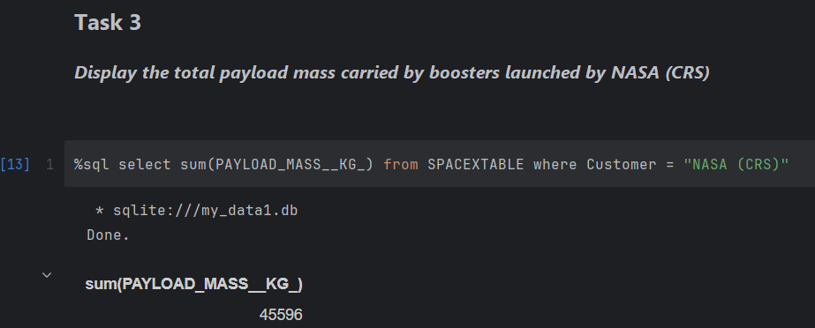
Total Payload Mass
Total payload carried by boosters from NASA

Slide 27
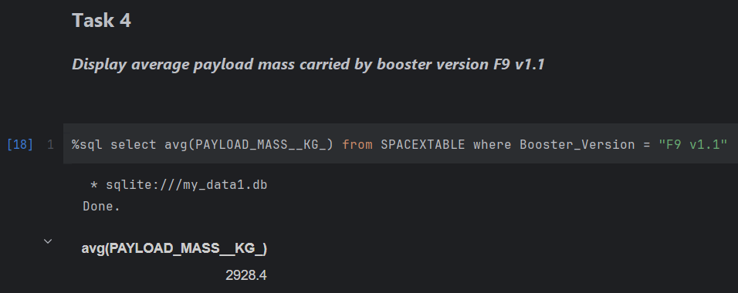
Average Payload Mass by F9 v1.1
Average payload mass carried by booster version F9 v1.1 by filtering booster version and use avg() keyword on payload mass column

Slide 28
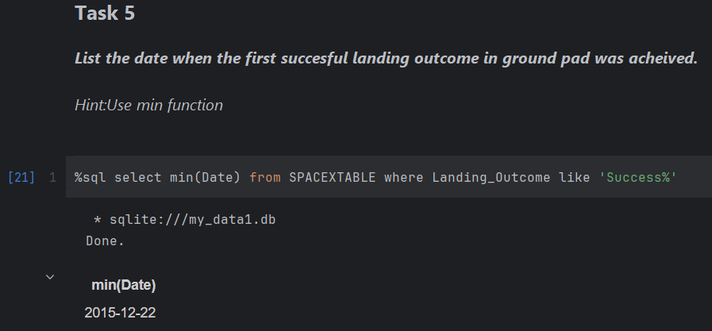
First Successful Ground Landing Date
Dates of the first successful landing outcome on ground pad:

Slide 29
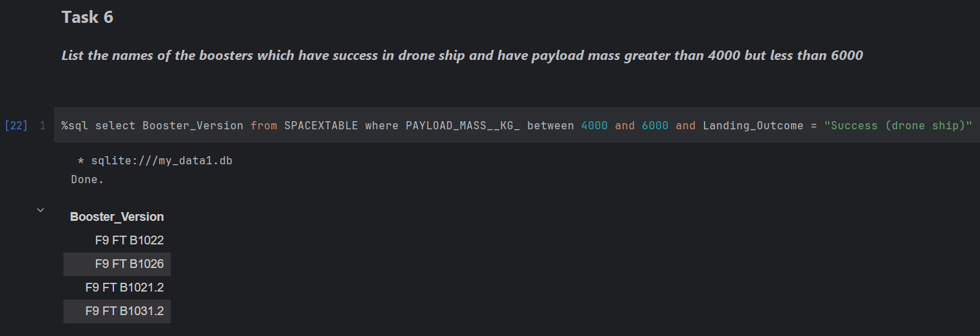
Successful Drone Ship Landing with Payload between 4000 and 6000
Successfully landed booster with payload mass between 4000 and 6000
Use keyword between, “and” with specified landing outcome.

Slide 30
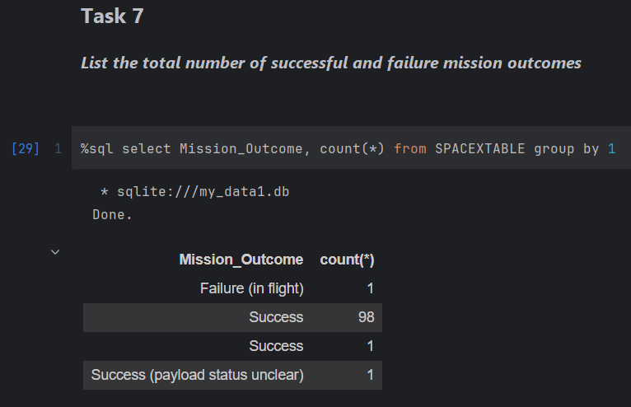
Total Number of Successful and Failure Mission Outcomes
Total number of successful and failure mission outcomes. Using count() keyword and group keyword to calculate numbers of individual outcomes

Slide 31
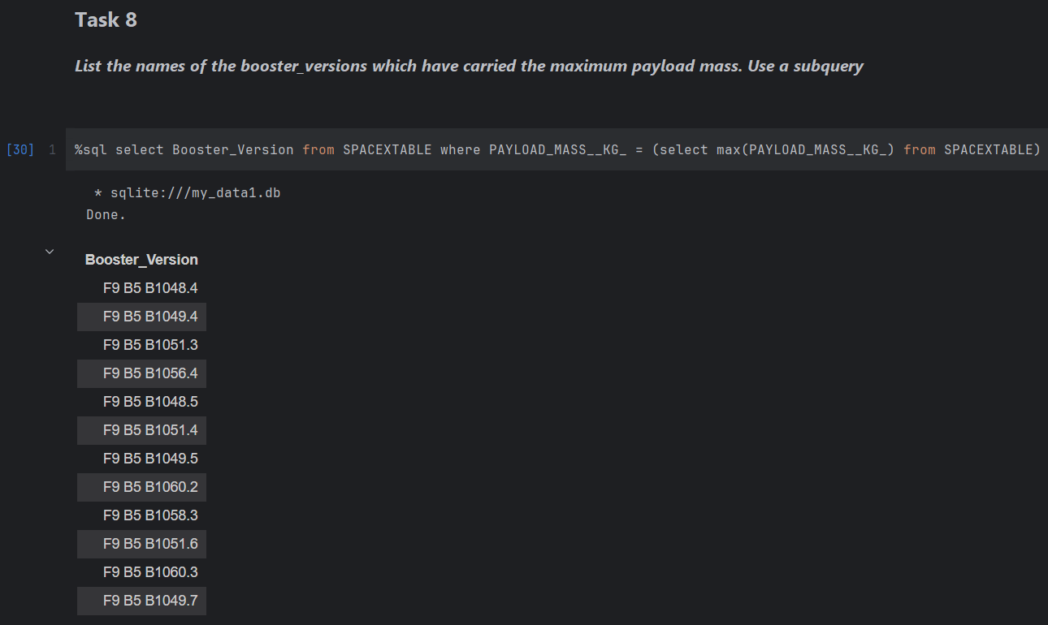
Boosters Carried Maximum Payload
Names of the booster with maximum payload mass using subquery that gets the max payload for filtering

Slide 32
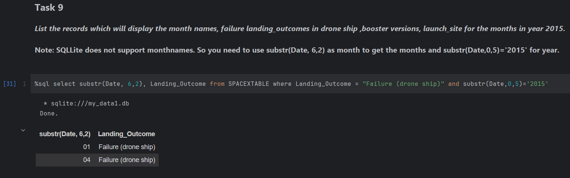
2015 Launch Records
Failed landing outcomes in year 2015 with specified columns and date requirements

Slide 33
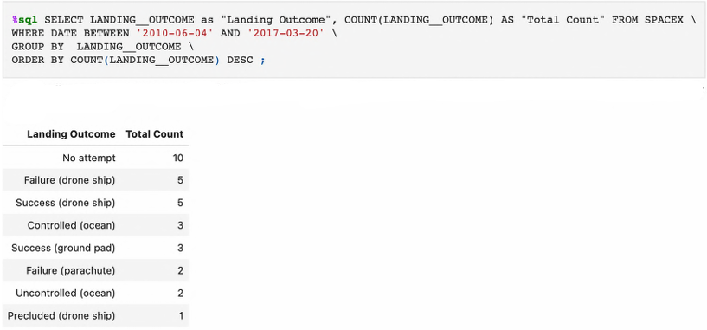
Rank Landing Outcomes Between 2010-06-04 and 2017-03-20
Rank number of landing outcomes between 2010-06-04 and 2017-03-20.
Use Count, where, group by and order by keywords to formulate this result

Slide 34

Section 3

Slide 35
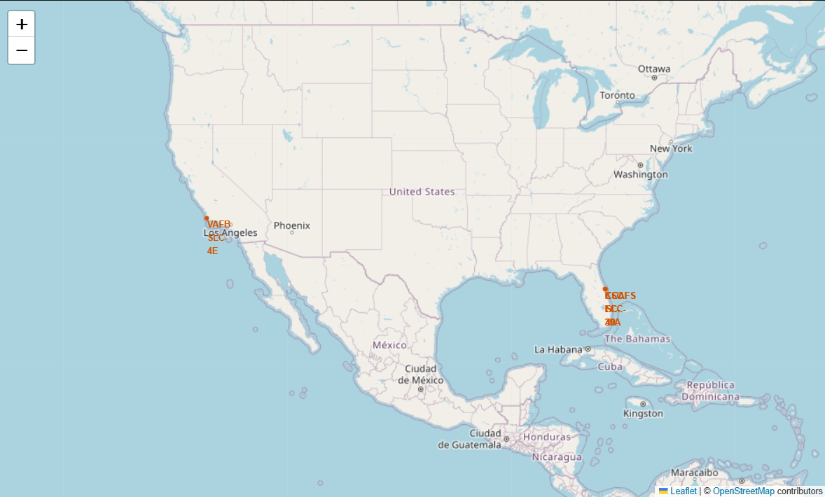
Location of launch sites in USA
The map includes all launch sites locations.
All launch site is located near the coastal area and with developed communication infrastructure

Slide 36
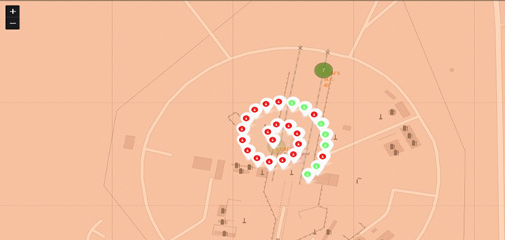
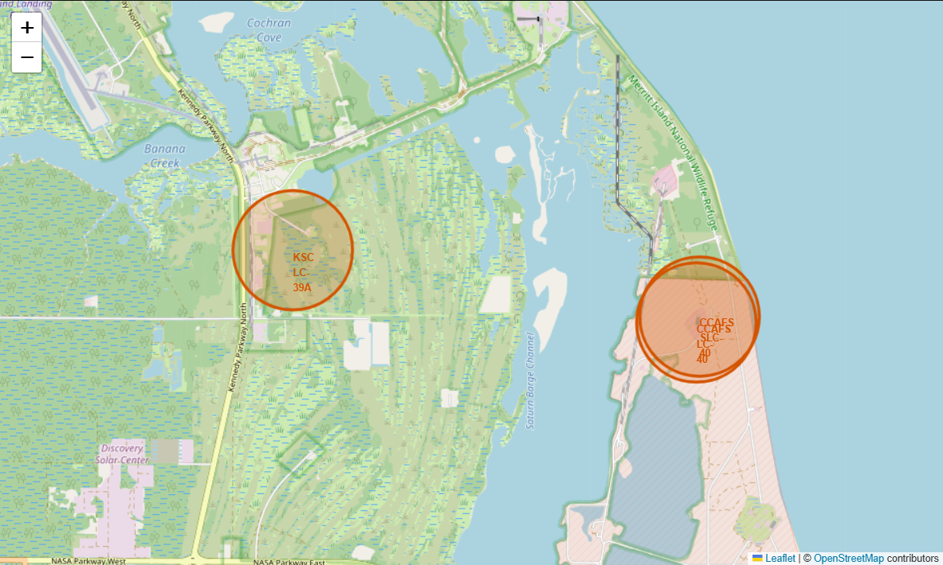
Launch outcomes for each site
This plot highlight the success and fail launch outcomes on map that is labelled with green and red label for identification.

Slide 37
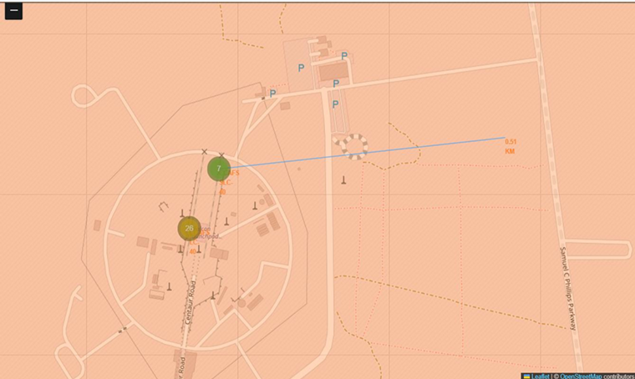
Distance from launch site to important locations
The launch site is close to the coastline but away from city.
0.9 km to coastline
29 km to highway
79 km to railway station
79 km to city

Slide 38

Section 4

Slide 39
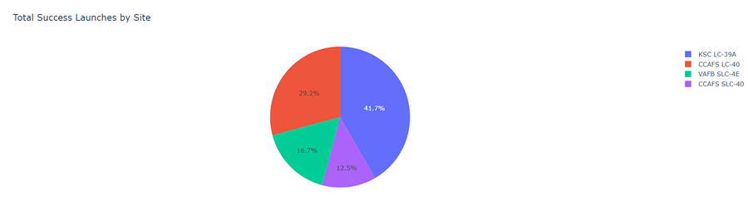
Distribution of successful launches by sites
From the Pie Chart we sees that KSC LC-39A have the highest number of successful launches compare to other sites

Slide 40
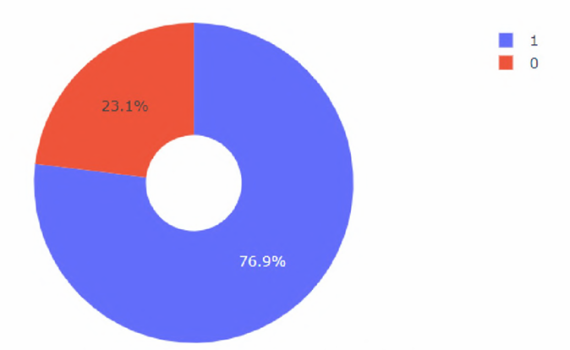
The launch statistic of KSC LC-39A site
The pie chart shows that KSC LC-39A site have a 76.9% success rate and a 23.1% unsuccessful rate.

Slide 41
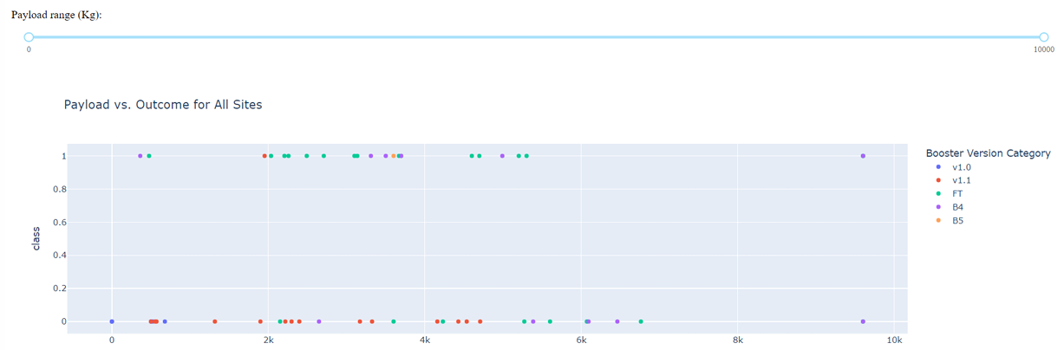
Distribution of launches across booster version over launch outcomes
The Scatter Plot shows that smaller payload have a relatively higher success rate compare to those with a larger payload

Slide 42

Section 5

Slide 43
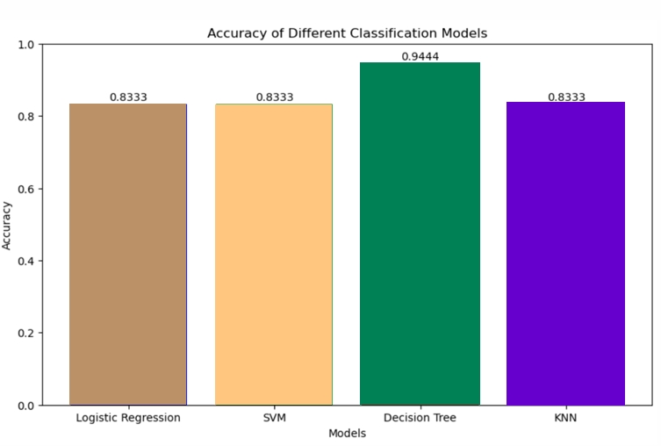
Classification Accuracy
Among the four classifications model, the decision tree classification models has the highest 94% accuracy.
The implies that the decision tree model best fit the dataset compare to other classification models

Slide 44
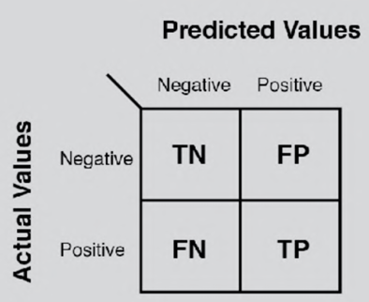
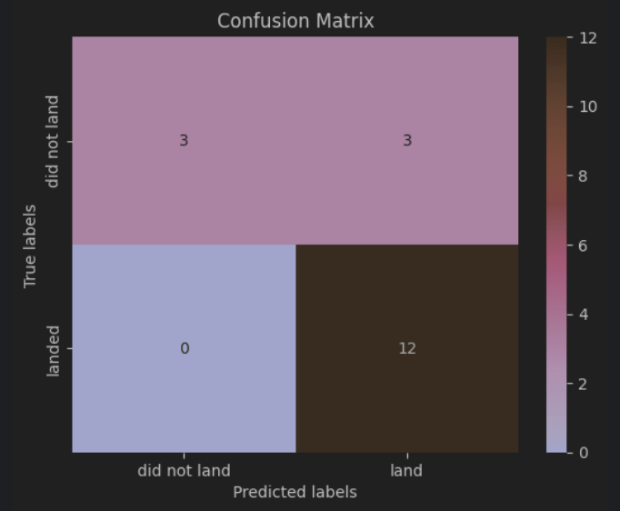
Confusion Matrix
Confusion matrix from the decision tree classifier shows that there’re several False Positive records made by the classifier, and the classifier has a high accuracy in predicting negative value.

Slide 45
Conclusions
SpaceX rocket launch techniques has been improved over the years
More large payload rockets is tested and launched, although with a slightly lower successful rate than small payload rocket
The launch site KSC LC-39A is the most ideal launch site with a highest successful rate
In terms of prediction models, the decision tree classifier algorithm perform the best in predicting the successful landing outcomes by absorbing the dataset provided by SpaceX API.

Slide 46
Appendix
Include any relevant assets like Python code snippets, SQL queries, charts, Notebook outputs, or data sets that you may have created during this project

Slide 47


